Slide 1



Slide 2





We are a
role-based
vendor-neutral
AI & Blockchain certification company
We focus on
10 practice areas
with over
40 Role Based Certifications
that align to AI in
core industries
Our purpose is to
promote the values of lifelong learning and we will do this by certifying a billion people to close the growing skills Gap!

Slide 3
As a starting point
for an individual
or company
Everyone
Executives
Sales
Marketing
Finance
Legal
…
As an add-on
to existing technology vendors
Microsoft
Google
AWS
CompTIA
EC-Council
PMI
…
As an anchor
into new industries Finance
Legal
Healthcare
Government
…
Notes:
Companies are realizing that Implementing AI requires skilling to increase AI Adoption to drive Actual Change

Slide 4
AI Continuous Change
is driving the need for
Continuous Learning A gift that keeps on giving!
AI Maturity Curve
ensures that enterprises are Always Evolving
Breadth & Depth!
AI Complexity
creates the need for a Trusted Advisor
That’s YOU!

Slide 5


Learning is a journey,
not a fixed Destination!
Foundational - Basic Knowledge for Everyone
What AI can do, what it can’t do, and any risks
Get everyone on the same page and ready for AI
Inclusivity and knowledge for everyone – Organization wide readiness
Functional - Role-Specific Skills
Teams need function specific training
Specialized Expertise - Expert-Level Skills
You need AI experts who can build and refine AI systems, find the best ways to use AI, and lead projects across teams
Get everyone in the organization AI-ready,
from foundational knowledge to specialized expertise.
Notes:
Basic Knowledge (Starting Point)
Everyone in the organization, regardless of their function, needs basic AI literacy.
They should understand AI’s capabilities, limitations, and potential risks.
This builds a solid foundation for organization-wide AI readiness.
Role Specific Skills (Functional layer) (Middle Points)
Teams need specific training to complete their roles. Think about training that’s useful for each team to connect it directly to goals and KPIs
HR – AI Tools for improving employee engagement
Marketing teams – Customer insights
Expert Level Skills (Milestones or Destinations)
AI experts who can build and refine AI systems, find the best ways to use AI, and lead projects across teams
By structuring your training initiatives like this, you ensure that everyone in the organization is AI-ready, from foundational knowledge to specialized expertise.

Slide 6
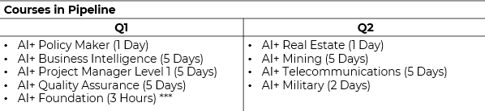

Professional Certification Portfolio | AICERTs Professional Certification Portfolio | AICERTs Professional Certification Portfolio | AICERTs Professional Certification Portfolio | AICERTs Professional Certification Portfolio
Technology Certification Portfolio | AICERTs Technology Certification Portfolio | AICERTs Technology Certification Portfolio | AICERTs Technology Certification Portfolio | AICERTs Technology Certification Portfolio
Essential | Business | Blockchain & Bitcoin | Design & Creative | Learning & Education | Specialization
Data & Robotics | Development | Security | Cloud | Blockchain & Bitcoin
AI+
Executive
AI+
Sales
Bitcoin+
Everyone
AI+
UX Designer
AI+
Educator
AI+
Healthcare
AI+
Data
AI+
Developer
AI+
Ethical
Hacker
AI+
Architect
Bitcoin+
Developer
AI+
Everyone
AI+
Marketing
Blockchain+
Executive
AI+
Design
AI+
Learning &
Development
AI+
Government
AI+
Robotics
AI+
Engineer
AI+
Cloud
Blockchain+ Developer
AI+
Network
AI+
Prompt Engineer Level 1
AI+
Researcher
Bitcoin+
Executive
AI+
Quantum
AI+
Prompt
Engineer Level 2
Bitcoin+
Security
AI+
Security Compliance
AI+
Human
Resources
AI+
Writer
AI+
Security
Level 1
AI+
Supply Chain
AI+
Security
Level 2
AI+
Finance
AI+
Security
Level 3
AI+
Customer Service
AI+
Legal
AI+
Project Manager
AI+
Ethics
AI+
Product
Manager
AI+
Chief AI Officer
www.aicerts.ai

Slide 7

Partner Benefits

Slide 8


Partner Benefits
Our global Authorized Training Partner network is an exceptional consortium of premier training organizations renowned for their excellence and versatility.
Training Delivery Options for Partner Deliveries:
Open enrollment schedules
Private group sessions | Custom training programs
Self-paced, eLearning
Content
Discounted exam bundles with training materials
Volume discounts
Resources
Comprehensive marketing support materials and Partner Portal
Specialized sales sessions available
Access to a wealth of Instructor resources and sessions

Slide 9

Expand Your AI+ Training Business with Exclusive Partner Benefits
To help accelerate your sales of AI+ courses, we have partnered with NetCom Learning and Lumify Works to provide AI CERTs Authorized Training Partners (ATPs) with two key benefits:
Resell NetCom’s AI+ class schedule at a 50% discount off the published price.
NetCom offers at least one class per month for every AI+ certification. You can download their schedule to add to your website, and NetCom will create a private microsite for you for student enrollment, with payment required at the time of registration.
Access NetCom’s AICT-certified instructors at their U.S. country rates, allowing you to deliver AI+ courses using your own instructors or NetCom’s, subject to availability.
Resell Lumify Works’ AI+ class schedule at a 50% discount off the published price.
https://www.lumifywork.com/en-au/schedules/?b=ai+certs
Reach out to Kara Flanagan for more details.
These options empower you to expand your AI+ course offerings, particularly in high-growth sectors such as Education, Healthcare, Finance, Legal, and Government.
For more details, contact Kara Flanagan at kara@aicerts.ai

Slide 10
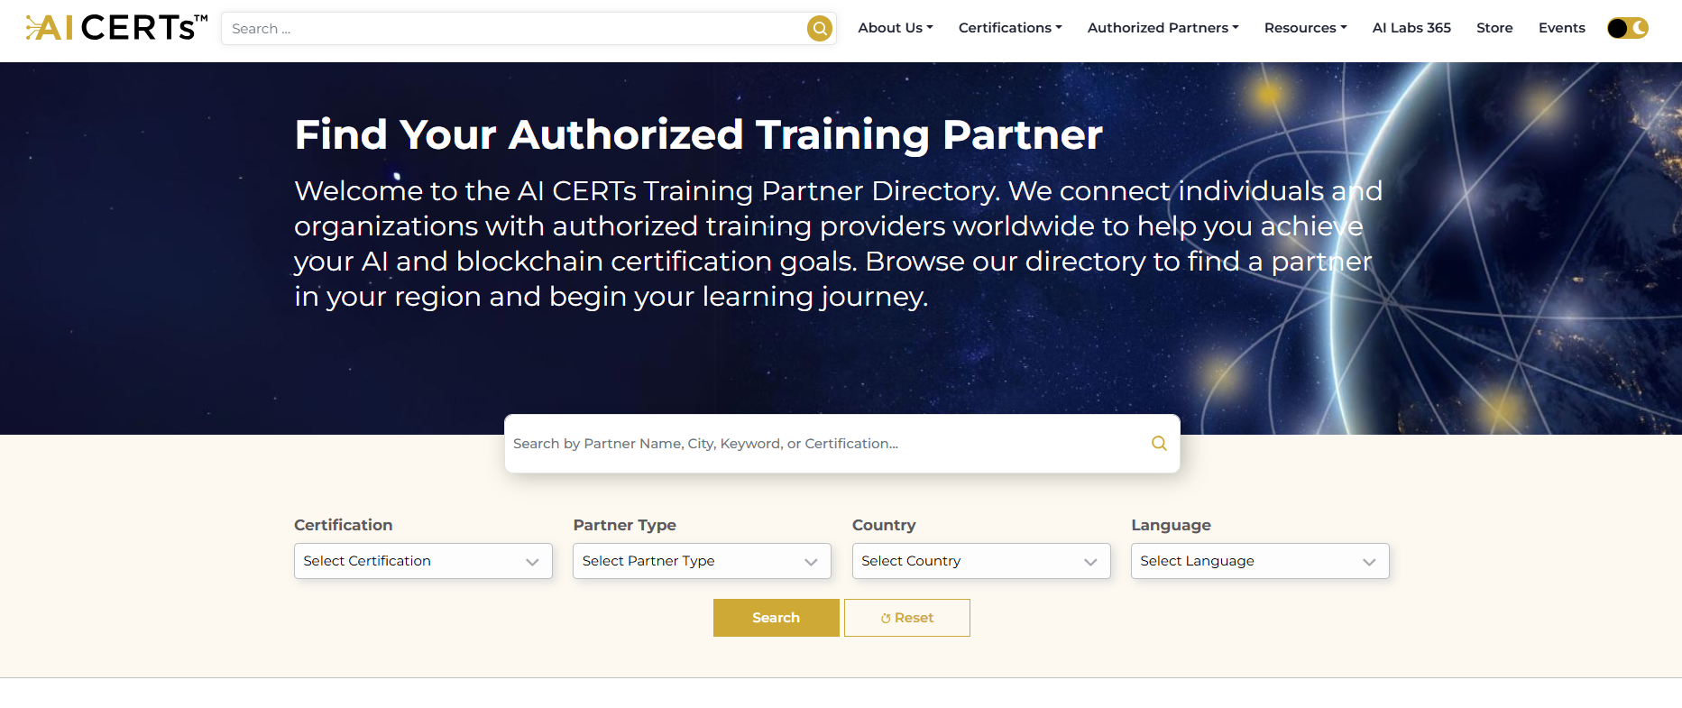
Leads emailed directly, not forwarded
Only shows classes you have a schedule for
Enables selection of language
Partner Locator

Slide 11
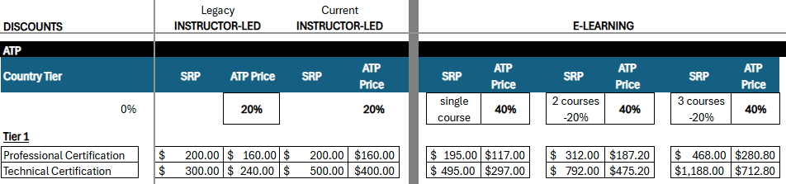
Exam/Content Pricing

Slide 12
Partner Levels
Partner level | SILVER | GOLD | PLATINUM
Prepay Amount | $1500 | $3000 | $5000
Certified Trainers | 1 | 2 | 3
Certified Sales Staff | 1 | 2 | 3
Our program is structured into tiers to recognize and reward
our partners' investment and achievements.

Slide 13
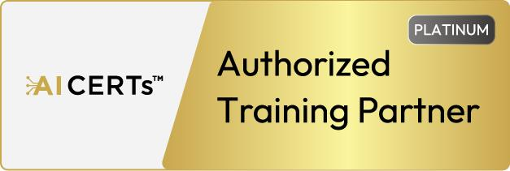


ATP Program Update - Partner Tiers
 | Annual Fee (Credit) | Effective Jan 1, 2026 (available now)
 | $5,000 (credit) | Listed first in partner search results Listed in select brand awareness campaigns Co-marketing opportunities
 | $3,000 (credit) | Listed second in partner search results Co-marketing opportunities
 | $1,500 (credit) | Listed third in partner search results

Slide 14
Certification Products Overview

Slide 15











Our Practice Areas
Essential
Data & Robotics
Development
Security
Learning & Educator
3 Certifications
3 Certifications
3 Certifications
6 Certifications
2 Certifications
Blockchain & Bitcoin
Business
Design & Creatives
Cloud
Specialization
6 Certifications
13 Certifications
2 Certifications
2 Certifications
2 Certifications
www.aicerts.ai

Slide 16
Professional Certification Portfolio | AICERTs Professional Certification Portfolio | AICERTs Professional Certification Portfolio | AICERTs Professional Certification Portfolio | AICERTs Professional Certification Portfolio
Technology Certification Portfolio | AICERTs Technology Certification Portfolio | AICERTs Technology Certification Portfolio | AICERTs Technology Certification Portfolio | AICERTs Technology Certification Portfolio
Essential | Business | Blockchain & Bitcoin | Design & Creative | Learning & Education | Specialization
Data & Robotics | Development | Security | Cloud | Blockchain & Bitcoin
AI+
Executive
AI+
Sales
Bitcoin+
Everyone
AI+
UX Designer
AI+
Educator
AI+
Healthcare
AI+
Data
AI+
Developer
AI+
Ethical
Hacker
AI+
Architect
Bitcoin+
Developer
AI+
Everyone
AI+
Marketing
Blockchain+
Executive
AI+
Design
AI+
Learning &
Development
AI+
Government
AI+
Robotics
AI+
Engineer
AI+
Cloud
Blockchain+ Developer
AI+
Network
AI+
Prompt Engineer Level 1
AI+
Researcher
Bitcoin+
Executive
AI+
Quantum
AI+
Prompt
Engineer Level 2
Bitcoin+
Security
AI+
Security Compliance
AI+
Human
Resources
AI+
Writer
AI+
Security
Level 1
AI+
Supply Chain
AI+
Security
Level 2
AI+
Finance
AI+
Security
Level 3
AI+
Customer Service
AI+
Legal
AI+
Project Manager
AI+
Ethics
AI+
Product
Manager
AI+
Chief AI Officer
www.aicerts.ai

Slide 17
Professional Certification Portfolio | AICERTs Professional Certification Portfolio | AICERTs Professional Certification Portfolio | AICERTs Professional Certification Portfolio | AICERTs Professional Certification Portfolio
Essential
Business
Specialization
Design & Creative
Learning & Education
Blockchain & Bitcoin
AI+ Executive
AI+ Everyone
AI+ Prompt Engineer Level 1
AI+ Foundation
AI+ Sales
AI+ Researcher
AI+ Writer
AI+ Finance
AI+ Legal
AI+ Ethics
AI+ Chief AI Officer
AI+ Product Manager
AI+ Marketing
AI+ Human Resources
AI+ Supply Chain
AI+ Customer Service
AI+ Project Manager Level 2
AI+ Project Manager Level 1
AI+ Real Estate
AI+ Healthcare
AI+ Government
AI+ Policy Maker
AI+ Military
AI+ UX Designer
AI+ Design
AI+ Educator
AI+ Learning & Development
Bitcoin+ Everyone
Bitcoin+ Executive
Blockchain+ Executive

Slide 18
Technical Certification Portfolio | AICERTs Technology Certification Portfolio | AICERTs Technology Certification Portfolio | AICERTs Technology Certification Portfolio | AICERTs Technology Certification Portfolio
Data & Robotics
Development
Security
Cloud
Blockchain & Bitcoin
AI+ Data
AI+ Quantum
AI+ Robotics
AI+ Business Intelligence
AI+ Quality Assurance
AI+ Mining
AI+ Developer
AI+ Engineer
AI+ Prompt Engineer Level 2
AI+ Telecommunications
AI+ Ethical Hacker
AI+ Security Compliance
AI+ Security Level 1
AI+ Security Level 2
AI+ Security Level 3
AI+ Network
AI+ Architect
AI+ Cloud
Bitcoin+ Developer
Bitcoin+ Developer
Bitcoin+ Security

Slide 19

Business Professional Solutions
AI Essentials | Blockchain & Bitcoin | Business | Design & Creative | Learning & Education | Specialization
AI+
Executive
Bitcoin+
Everyone
AI+ Sales
AI+
Finance
AI+
UX Designer
AI+
Educator
AI+
Healthcare
AI+
Everyone
Blockchain+
Executive
AI+ Marketing
AI+ Customer Service
AI+
Design
AI+ Learning &
Development
AI+
Government
AI+ Prompt
Engineer Level 1
Bitcoin+
Executive
AI+ Researcher
AI+
Legal
AI+ Human Resources
AI+ Project Manager
AI+ Writer
AI+ Ethics
AI+ Supply Chain
AI+ Product Manager
AI+
Chief AI Officer
www.aicerts.ai

Slide 20
Technical Solutions
Data & Robotics | Development | Security | Cloud | Blockchain & Bitcoin
AI+
Data
AI+
Developer
AI+ Ethical
Hacker
AI+
Architect
Bitcoin+
Developer
AI+
Robotics
AI+
Engineer
AI+
Network
AI+
Cloud
Blockchain+
Developer
AI+
Quantum
AI+ Prompt
Engineer Level 2
AI+ Security Compliance
Bitcoin+
Security
AI+ Security
Level 1
AI+ Security
Level 2
AI+ Security
Level 3
www.aicerts.ai

Slide 21

Agents, Agents, Agents
AI agents are shifting from augmenting humans to operating autonomously, managing tasks, driving efficiency, and transforming industries. Their expanding applications make understanding AI agents critical.
By March 31st, we are adding to every released course an optional "AI Agents" module that discusses how AI Agents are starting to impact that particular practice area, including related agent tools, technologies and demos.
In H2, we will be releasing a new category of certifications called AI Agents+ to support AI-mature individuals and enterprises who already using AI and are looking at AI Agents as the next level of autonomous automation.
See Sales Enablement Document in the Partner Portal
Notes:
https://partners.aicerts.io/wp-content/uploads/2025/03/AI-CERTs-Agentic-Module-Shaping-the-Future-of-Work.pdf

Slide 22
Top Courses
Instructor Led
AI+ Executive ™
AI+ Prompt Engineer Level 1™
AI+ Everyone™
AI+ Ethics™
Blockchain+ Executive™
AI+ Sales™
AI+ Project Manager™
AI+ Educator™
Blockchain+ Developer™
AI+ Developer™
AI+ Cloud™
AI+ Customer Service™
AI+ Marketing™
AI+ Learning & Development™
AI+ Data™
Self-Paced e-Learning
AI+ Prompt Engineer Level 1™
AI+ Project Manager™
AI+ Writer™
AI+ Data™
AI+ HR™
AI+ Developer™
AI+ Executive ™
AI+ Marketing™
AI+ Finance™
AI+ Customer Service™
AI+ Everyone™
AI+ Sales™
AI+ Educator™
AI+ Robotics™
AI+ Ethics™
Notes:
December
AI+ Executive
AI+ Ethics
AI+ Prompt Engineer
AI+ Customer Service
AI+ Educator
AI+ Learning & Development
AI+ Legal
AI+ Finance
AI+ Project Manager
AI+ Security
AI+ Government
AI+ Writer

Slide 23
Course Release Schedule Process
Alpha → Beta → Public
🔹 Alpha Phase (Trainer Onboarding & Internal Testing)
✔ Exclusive access for trainers via a dedicated portal
✔ Trainers complete the course & exam, providing feedback
✔ Content refinement & system testing before wider rollout
🔹 Beta Phase (Partner Access & Market Preparation)
✔ Course made available to partners through portals
✔ Marketing & sales teams initiate pre-launch campaigns
✔ Final system checks & scalability testing
🔹 Public Release (Official Launch & Open Enrollment)
✔ Course listed on AI CERTs store & website
✔ Public announcement with press release & marketing push
✔ Open enrollment with full customer support
✅ Phased approach ensures quality, scalability, and a seamless launch!!

Slide 24
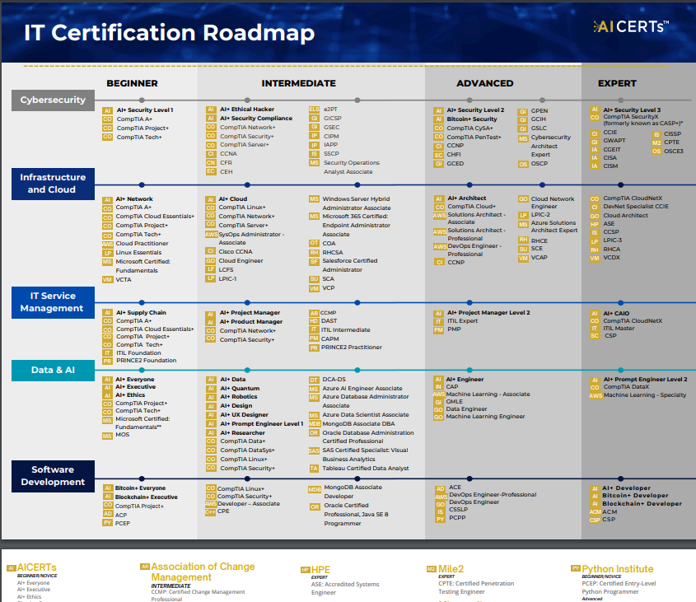
Sales
Resources
Download IT Certifications Vendor Map from the Partner Portal
Notes:
https://partners.aicerts.io/wp-content/uploads/2025/02/AI-CERTs-IT-Certifications-Vendor-Map-Draft.pdf

Slide 25
Content & Platforms

Slide 26
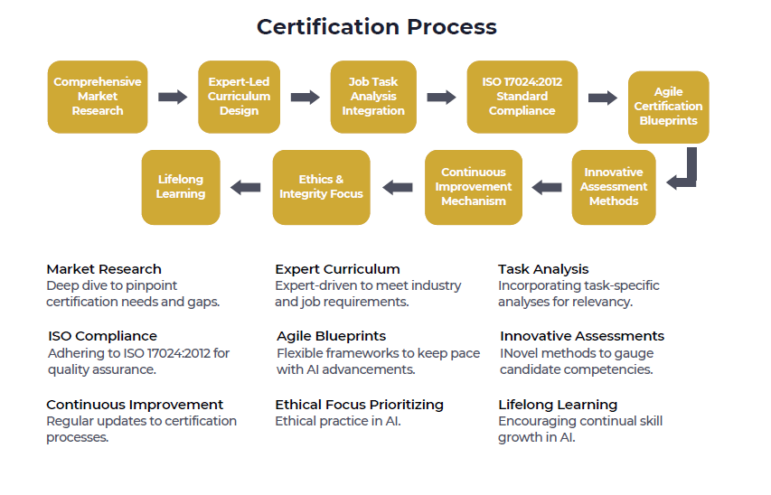
21%
Notes:
Comprehensive Market Research:
"This step involves a deep dive into current market trends and projections, gathering insights directly from industry leaders to ensure our certification meets the market's actual needs."
Expert-Led Curriculum Design:
"Our curriculum is designed by a team of subject matter experts and experienced educators, ensuring a rich blend of theoretical knowledge and practical skills that are directly applicable in the workplace."
Job Task Analysis Integration:
"We perform a detailed analysis of job roles to define the necessary skills and competencies, aligning our certification with real-world job functions and employer expectations."
ISO 17024:2012 Standard Compliance:
"Our process is in strict adherence to the ISO 17024:2012 standards, ensuring the certification is impartial, consistent, and recognized on a global scale."
Dynamic and Flexible Curriculum:
"The curriculum is continuously updated to reflect the latest industry innovations and best practices, equipping learners with the knowledge to meet current and future challenges."
Innovative Assessment Methods:
"We employ advanced and interactive assessment methods, utilizing technology to create realistic scenarios that accurately gauge a candidate’s abilities."
Continuous Improvement Mechanism:
"A structured mechanism for incorporating stakeholder feedback ensures that our certification process remains adaptive, responsive, and aligned with evolving industry standards."
Ethics and Integrity Focus:
"Ethical practices and integrity are woven into the fabric of our curriculum, emphasizing the importance of professional conduct and accountability."
Lifelong Learning:
"We advocate for continuous professional growth and provide ongoing resources and support to our certificate holders, fostering a culture of lifelong learning."

Slide 27
Course Content Overview
Instructor-Led Course |  | Self-Paced e-Learning Course
Instructor version | Student version
AICT discussion forum Instructor Guide Course PowerPoint Session Guide Exam Blueprint Detailed Curriculum Tools List Resources and References Feedback Survey | One-year subscription (with all updates): High-Quality E-Book AI Mentor for Personalized Guidance Quizzes, Assessments, and Course Resources Exam Study Guide Proctored Exam with One Free Retake | One-year subscription (with all updates): High-Quality Videos and E-Book AI Mentor for Personalized Guidance Quizzes, Assessments, and Course Resources Exam Study Guide Proctored Exam with One Free Retake

Slide 28
Self-Paced e-Learning
For certifications where you are not delivering the instructor-led course, consider offering the self-paced e-Learning course.
Authorized Partners receive a 40% discount off all prices listed on our online store including bundles (https://store.aicerts.ai). Order through the Partner Portal!
All courses available now available!
What’s Included?
One-year subscription (with all updates):
High-Quality Videos and E-Book
AI Mentor for Personalized Guidance
Quizzes, Assessments, and Course Resources
Exam Study Guide
Proctored Exam with One Free Retake
Self-Paced e-Learning launched
AI+ Chief AI Officer
AI+ Security Level 1
AI+ Network
AI+ Security Level 3
Bitcoin+ Security
AI+ Security Compliance
AI+ Prompt Engineer Level 2
AI+ Supply Chain

Slide 29
Platforms
Learner | Trainer | Partner

Slide 30
Portals
Partner Portal:
This platform has everything a partner needs to sell and market courses plus enroll students in one platform.
Learner Portal:
This platform is designed for students who have been enrolled in instructor-led courses and/or self-paced e-Learning courses.
Trainer Portal:
A specialized platform exclusively designed for Trainers, providing access to both the Student and Trainer versions of the instructor-led courses.
Trainer Version: This version is specific to helping the Trainer prepare for and to deliver the instructor-led course and includes Instructor Guide, Course PowerPoint, Session Guide etc.
Student Version: This is the same version as the student accesses through the Learner Portal

Slide 31
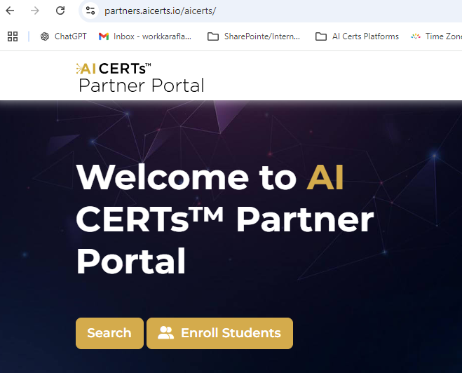
What’s in the Partner Portal?
Online Student enrollment process
Sales Enablement Resources
Marketing Resources
Partner Portal
https://partners.aicerts.io/

Slide 32
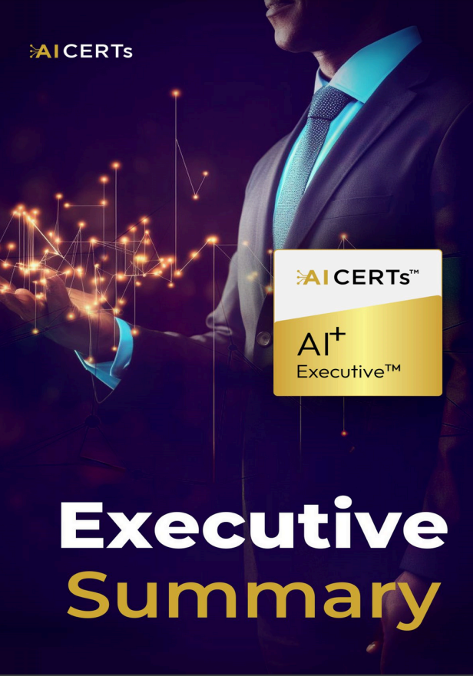
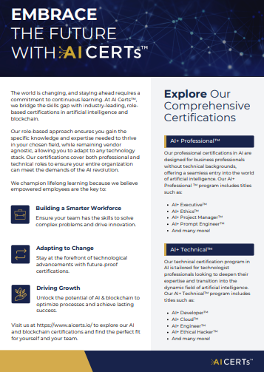
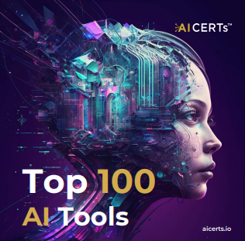
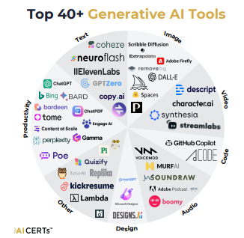
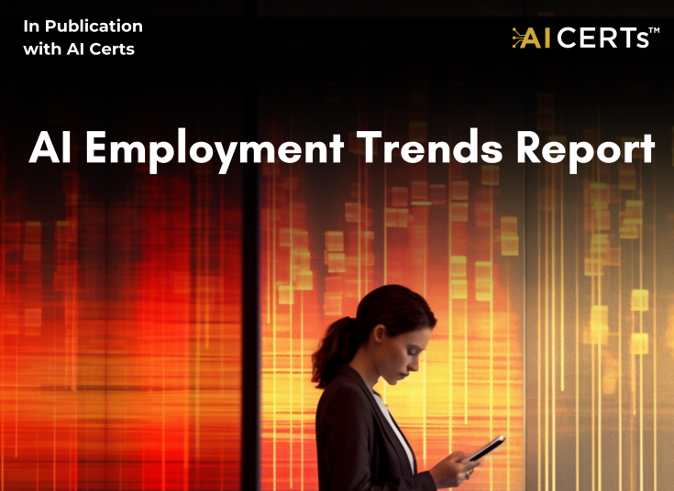



Sales Enablement Materials
Certification Blueprints
Executive Summaries
Battle Cards (internal)
Course Outlines
White Papers
Videos
Templates
Articles and White Papers

Slide 33
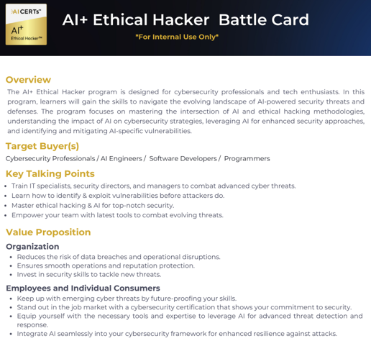
Battle Cards (Internal Only)
Topics include:
Target Buyer(s)
Key Talking Points
Value Proposition
B2B and Enterprise
Organization
Employees and Individual Consumers
Core Topics Covered and Tested
Relevant Statistics
Who Should Get Certified
Objections and Reframes
Battle Cards are designed to provide sales representatives vital information about the certification as well as the intended target market(s).

Slide 34
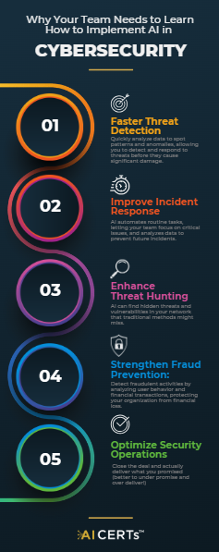
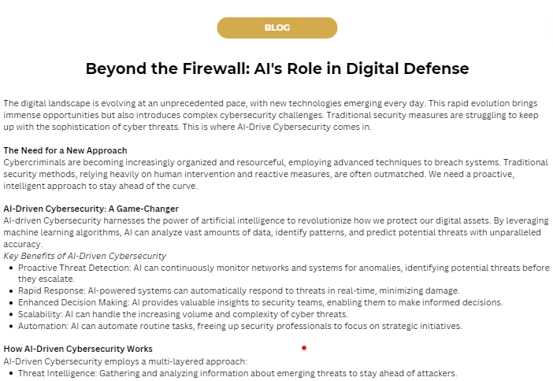
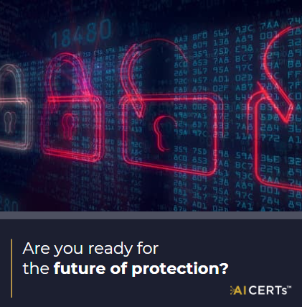
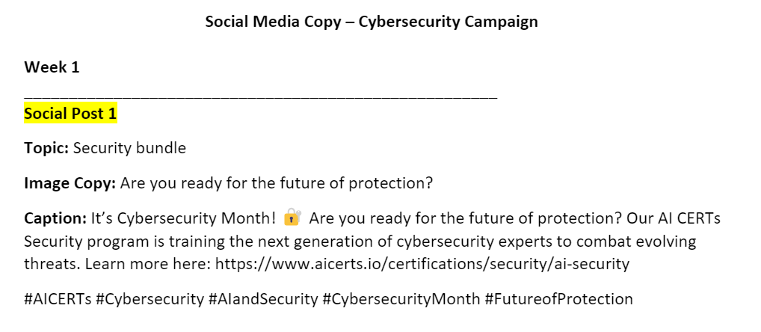

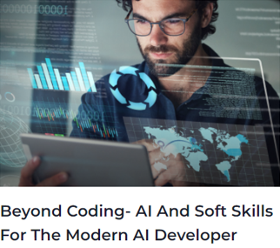
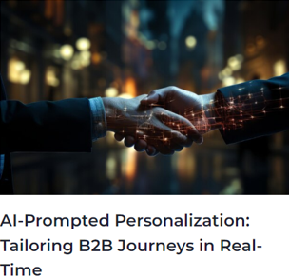

Marketing Items
Onboarding Documents
Comprehensive Marketing Campaigns
Overview
Social posts
Graphics and visuals
Emails
Lead magnets
Talking points
To vary each month
Brand Guidelines
Provides partner organizations with details on how to use various logos, badges, etc.
Social Content
Why AI CERTs is the industry leader
Trends in AI
Stories and articles on trending AI topics
Updates to the AI CERTs offerings

Slide 35
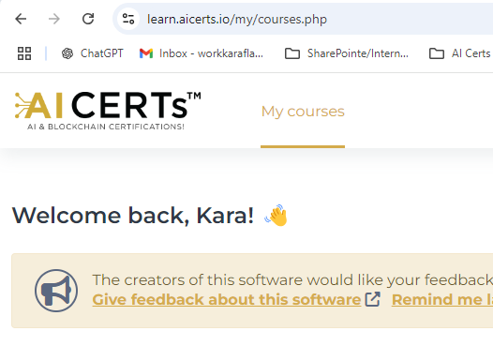
What’s in the Learner Portal (LMS)?
Regular Content
E-Courseware
Summary Videos
Certification Blueprint
Detailed Course Curriculum
Related Tools
Course Resources
Certification Exam
Remote Proctor
2 attempts
Learner Portal
https://learn.aicerts.io/

Slide 36
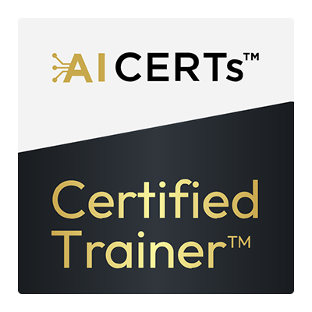
What’s in the Trainer Portal?
Trainer Content
All Student Content
Trainer Portal
+
Trainer Prep Courses
Instructor Guide & Trainer PowerPoint
Trainer Session Planner
They are also enrolled in the student version inside the Trainer Portal
Resources & Support
Trainer Portal
AICT Database
AICT Newsletter
Training Manager Meetup
Quality assurance
End-of-class surveys
End-of-year awards
https://trainer.aicerts.io/

Slide 37
AI Certified Trainer (AICT) Program

Slide 38
AICTs Program Updates
AICT exam pass rate reduced from 90% to 70%
Trainer the Trainer Program
Objective: Equip trainers with essential skills and knowledge to effectively teach AI CERTs certifications.
Session Duration: Minimum 45 minutes.
Key Focus Areas:
Teaching techniques and learner engagement strategies.
In-depth overview of certification modules, including examples, use cases, and labs.
Q&A session to clarify doubts and provide constructive feedback.
Outcome: Empower trainers to lead sessions with confidence and ensure effective knowledge transfer.
(3) Test Teaching Session
Duration: 30 minutes.
Purpose: Evaluate trainers before they lead live classes to ensure they meet AI CERTs' instructional standards.
Focus Areas:
Presentation and communication skills refinement.
Identifying areas for improvement and providing targeted solutions.
Goal: Ensure trainers are fully prepared for live instruction and can deliver high-quality training.

Slide 39
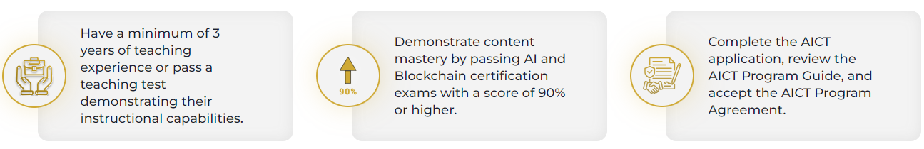
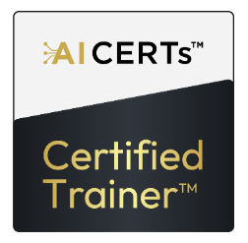
AI Certified Trainer (AICT) Program (https://www.aicerts.ai/aict-program)
Requirements
Must first pass AI+ Executive certification exam with 70% to be authorized to teach course
Recommended core: AI+ Executive / Everyone / Ethics / Prompt Engineer Level 1
Each additional course to be taught requires passing related certification exam
Send weekly/monthly class surveys to support@aicerts.ai
Trainer Course Access (available at no cost in the Trainer Portal)
Trainer version of instructor-led course (with Instructor Guide, Trainer PowerPoint, Session Planner etc)
Student version of instructor-led course (same as what student access in Learner Portal)
Self-paced e-Learning course version (different format from instructor-led course available in the Learning platform only)
AICT Certification
Trainers receive AICT certification badge after meeting all program requirements
Trainers can contact support for assistance: support@aicerts.ai
Upcoming in Q1
Train the Trainer Sessions
Trainer Marketplace – independent, verified trainer pool for partners
Before your Instructors teach a new course, please reach out for a 30-minute,
Train the Trainer meeting.
Notes:
To receive the AICT Certified Trainer Certification, which acknowledges that the trainer has met all requirements to be recognized as an AI Certs Certified Trainer (AICT), trainers may contact the support team for assistance in obtaining the certification.
support@aicerts.ai

Slide 40
Thank you!
If you have any additional questions
or thoughts, please contact:
Kara Flanagan, Head of Partnerships kara@aicerts.ai
www.aicerts.ai

