Slide 1

AI CERTs DECK
Visit Our Website:
www.aicerts.io

Slide 2




Who we are?
AI CERTS offers a comprehensive portfolio of AI and Blockchain certifications designed to disrupt the professional learning industry
Our purpose is to promote the values of lifelong learning.
We help companies build a smarter workforce, adapt to change, and drive growth.
offers role-based AI & Blockchain Certifications
Our mission is to certify a billion people!

Slide 3


Problem!
However, shortage of the skilled talent is one of the biggest barrier for AI Adoption.
Why do companies struggle to adopt AI
technologies? (2023)
Employers believe lacking AI skills is a
barrier to adopt AI (2023)
%of Employer
1
Skills Gap
33%
49%
47%
48%
41% ^{42%} 37%
33%
42%
2
Data Complexity
25%
3
Integration
Challenges
22%
4
Lack of Tools
21%
5
Cost Barrier
21%
UK
Franc
e
Irelan
d
Austri
a
German
y
US
A
Canada
%of Employer
42%
employers of the major economies believe a shortage of AI skills
Source: OECD, IBM

Slide 4
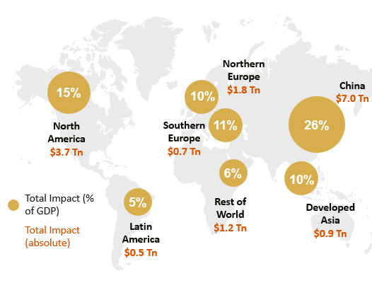


Why does it matter?
AI is expected to contribute to around $15.7 Trillion to global economy by 2030.
The Demand for AI Skills is skyrocketing
Global Impact of AI in 2030
$1811.8 Bn
AI in 2030
37.3%
CAGR (2023-30)
Global AI market size
$270.5 Bn
AI Today (2024)
Source: Forbes, IBM, PWC

Slide 5


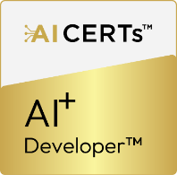
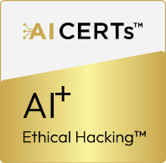
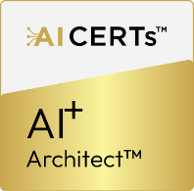
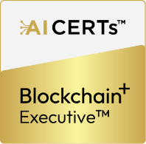
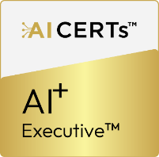
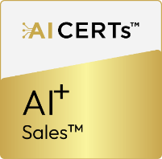
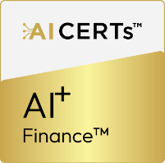
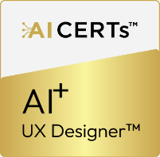


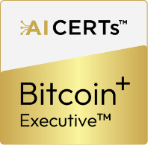
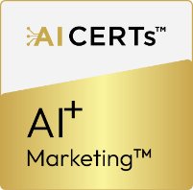
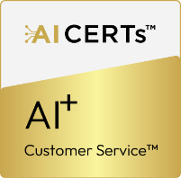
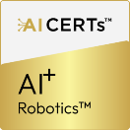
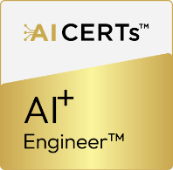
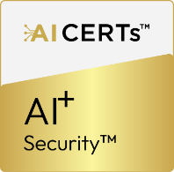
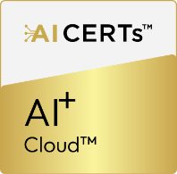

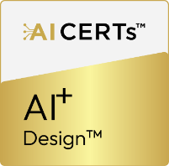
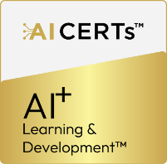



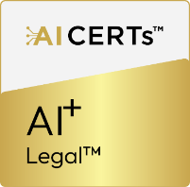
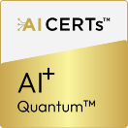

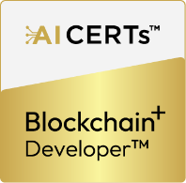
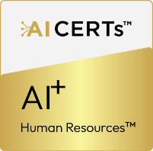
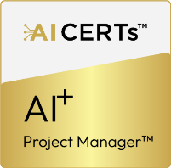
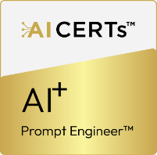



Our Solution​
AI CERTs certifications empower organizations to upskill their teams, stay competitive in the marketplace, and harness the power of AI and Blockchain technologies.
Bridging the AI skills gap with our comprehensive certification programs
Technology Certification Portfolio |  |  |  |  | Professional Certification Portfolio
Data & Robotics | Development | Security | Cloud | Blockchain & Bitcoin | Essentials | Business | Design & Creative | Learning & Education | Specialization
21%

Slide 6


Course Bundle Includes
E-Courseware
Certification Blueprint
Detailed Course Curriculum
Related Tools
Course Resources
Summary Videos
Certification Exam

Slide 7











How Do We Add Value?
AI CERTS offers role-based certifications tailored to IT and other industry professionals targeting specific job functions with global recognition and quality assurance
Comprehensive Certification™ Portfolio
Industry Recognition and Validation
Value Proposition
Pioneering in AI and Blockchain Convergence
Extensive Network of Subject Matter Experts
Innovative Certification Testing
Expertise-Driven Team
Social Impact and Global Vision

Slide 8

Certification Development Process
Role Based Certification Development Process
Comprehensive Market Research
Expert-Led Curriculum Design
Job Task Analysis Integration
ISO 17024:2012
Standard Compliance
Agile Certification Blueprints
Innovative Assessment Methods
Continuous Improvement Mechanism
Ethics and Integrity Focus
Lifelong Learning

Slide 9
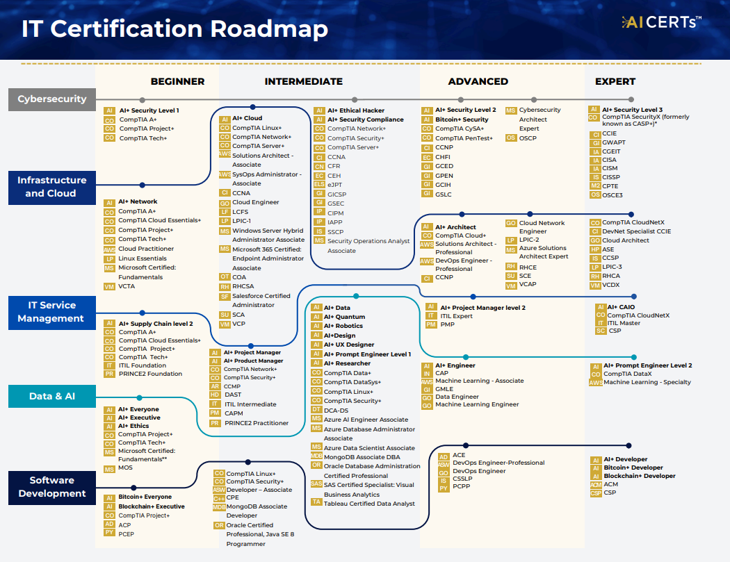
Draft Version

Slide 10








What is AICERTs’ proposition to the opportunity?
What is AICERTs’ proposition to the opportunity
AI CERTs certifications empower learners to advance their careers, differentiate themselves in the marketplace, and drive tangible business results by acquiring AI and Blockchain Skills
AI CERTs certifications empower learners to advance their careers, differentiate themselves in the marketplace,
and drive tangible business results by acquiring AI and Blockchain Skills
Diverse range of
Certifications
30+ AI & Blockchain Certifications
Industry recognition & validation Trusted by industry giants
Role based
Certifications
Professional &
Technical certifications
Why AI CERTs?
Globally recognized
accreditation
Industry aligned
Certifications
Visionary AI/Edtech Leader
Visionary leaders craft
high impact programs
Pursuing ANAB
accreditation
Vast network of 1000+ Subject matter expert

Slide 11


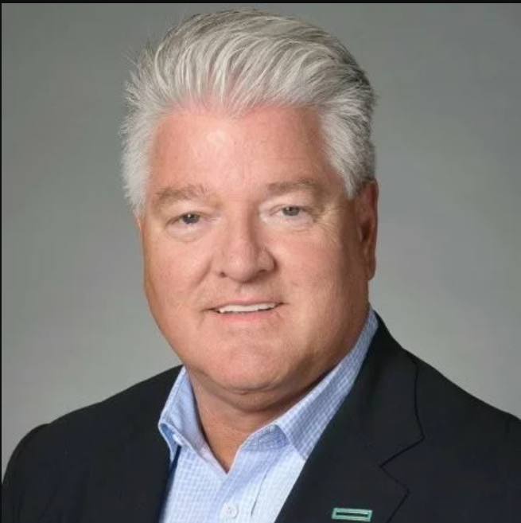

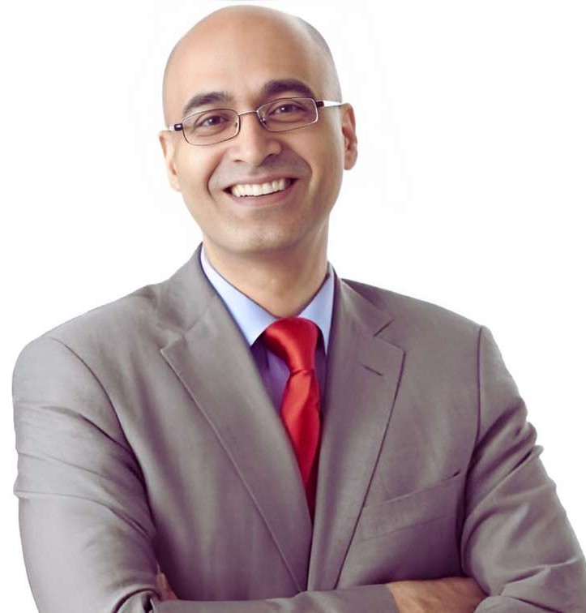
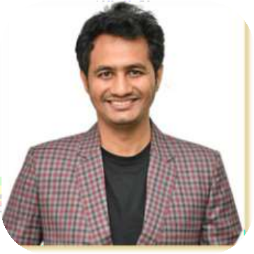

We Have An Amazing Team
Our team is experienced and possesses extensive industry know-how. With over 100 years of cumulative experience, we are thriving for the success
Gordon Pelosse
EVP of Partnership and Enterprise Strategy
David Fremed
CFO
Russell Sarder
Chairman & CEO
Chintan Dave
Head of India & General Manager
Ben Watson
Chief Commercial Officer

Slide 12
Visit Our Website:
www.aicerts.io

